Slide 1
Global Coaches House 2012
Lessons From the Games
Sergio Lara-Bercial
Senior Research Fellow – ICCE
Leeds Metropolitan University
s.lara-bercial@leedsmet.ac.uk

Slide 2
Key Facts
Ran during the Olympics and Paralympics in London
Aimed to provide a common space for coaches from all over the world to share, learn, socialise and rest
Provided open access and dedicated programmes
Supported by Leeds Metropolitan University, Limkokwing University, Dartfish, Human Kinetics and WADA.

Slide 3
Key Facts
450+ coaches from 20+ countries and 25+ sports
60+ presentations, 40+ presenters
80+ hours of footage…
Special Events: Opening and Closing Ceremony, Performance Summit, Launch of International Sport Coaching Framework, Leeds Met Night, Winning Women Day, Rugby Day, Race-Walking Day, Technology Day…

Slide 4
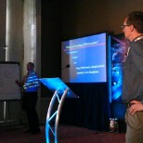
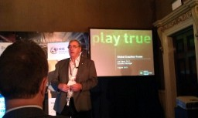
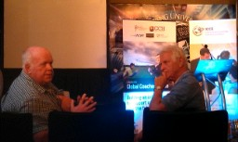
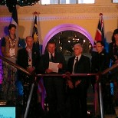
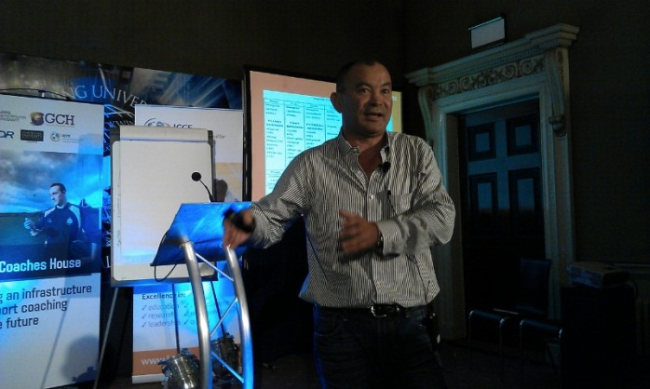
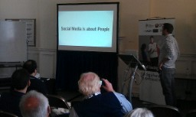
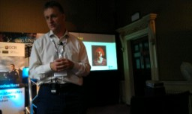
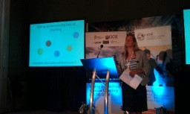
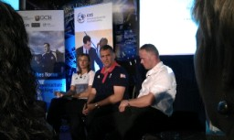
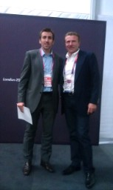
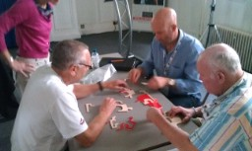
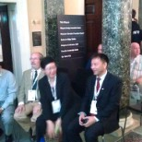
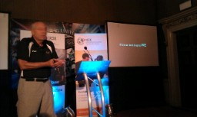
Key Facts

Slide 5
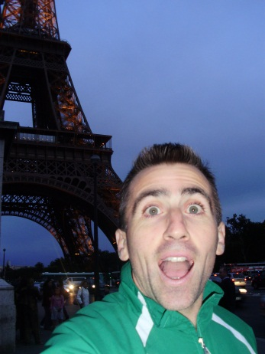
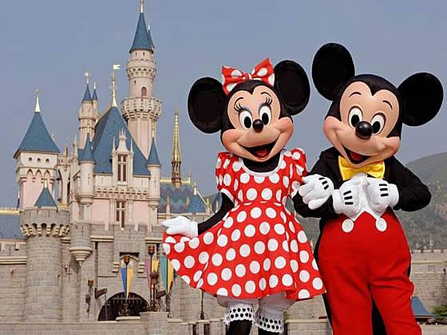
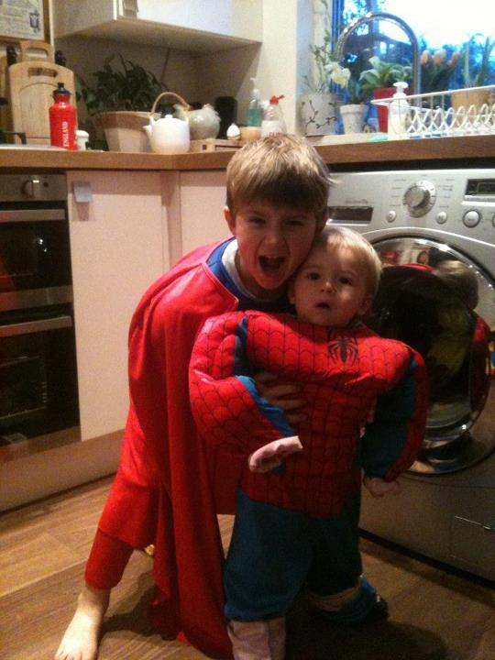
Quick Moment of
Self-Reflection
was to
what
is to

Slide 6
What did we know?

Slide 7
Core Functional Areas of the Coach
Coaches…
Create the Vision and Strategy
Shape the Environment
Conduct Practice and Competition
Read and React to the Field
Reflect and Learn
Build Relationships and Influence

Slide 8
Core Functional Areas of the Coach
Coaches will need to draw, integrate and apply three types of knowledge:
(Côté and Gilbert, 2009)
Professional Knowledge
Interpersonal Knowledge
Intrapersonal Knowledge

Slide 9
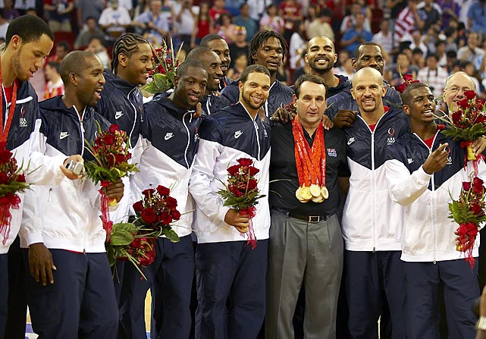
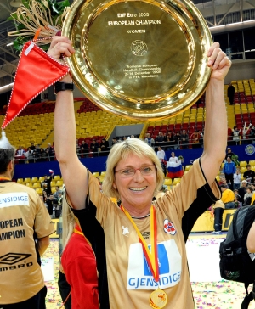
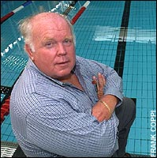
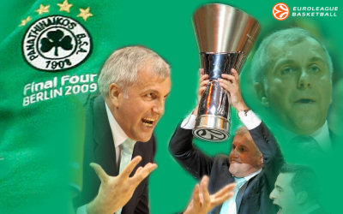
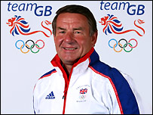
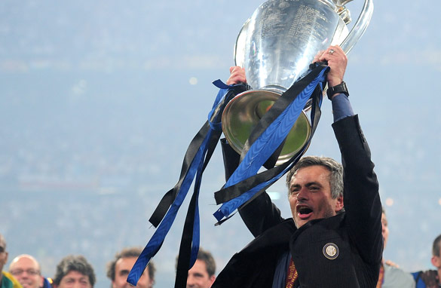
The Serial Winning Coach
Project
Serial Winner: ‘A coach who has won gold medals and major titles at the highest level of competition over a prolonged period of time and with different athletes or teams’
Overall, around 20 coaches and 150+ Gold Medals and Major Championships between them!!

Slide 10
So what do you think?
Create the Vision and Strategy
Shape the Environment
Conduct Practice and Competition
Read and React to the Field
Reflect and Learn
Build Relationships and Influence
In groups of 5:
Put the 6 CFAs in order of importance according to you
What do coaches do in those areas? Each group to work on 2 areas.

Slide 11
So what did GCH and the SWCs tell us about these areas?
Create the Vision and Strategy
Shape the Environment
Conduct Practice and Competition
Read and React to the Field
Reflect and Learn
Build Relationships and Influence

Slide 12
Create the Vision and Strategy GCH
The main job of the coach is to invent the future – Dr. Frank Dick OBE
Conduct a Performance Audit on three key points where you need to close/open a gap with your opponents: the quality of your coaching, your competition plans and how to recruit better athletes – Bill Sweetenham
By the time you copy what we do we will be doing something different – Eddie Jones
We live in a karaoke world, constantly trying to imitate the person next to you. The only way is to have not a complex of inferiority or superiority, but a complex of INTERIORITY’ – Caroline McHugh
Create the Vision and Strategy
Shape the Environment
Conduct Practice and Competition
Read and React to the Field
Reflect and Learn
Build Relationships and Influence

Slide 13
Create the Vision and Strategy SWC
You have to do what you do, and not what someone else does. And it changes each and every single year.
We (the coaching staff) come up with the best plan. It’s not my way, it’s our way.
My biggest strength is that I help people understand why
Of course I have a vision and a plan, but I’m prepared to change it everyday
Be orientated on performance-goals, not on result-goals
You need to have a very clear idea of what you are doing
Create the Vision and Strategy
Shape the Environment
Conduct Practice and Competition
Read and React to the Field
Reflect and Learn
Build Relationships and Influence

Slide 14
Shape the Environment GCH
I look for people that are open minded and loyal – Bill Sweetenham
You have to find the Tea Ladies within your environment , those who see everything and know everything – Bill Sweetenham
The coach has to be in charge of his own destiny – Dean Benton
A camel is a horse made by committee – Vern Gambetta
I know I am biased and that I will spend more time working on the things I enjoy the most, that’s why I bring in other people to make sure the things I don’t like doing get done because they also are important – Stan Madiri
Lots of independently unremarkable things amount to remarkable outcomes – Caroline McHugh
Create the Vision and Strategy
Shape the Environment
Conduct Practice and Competition
Read and React to the Field
Reflect and Learn
Build Relationships and Influence

Slide 15
Shape the Environment SWC
I am looking for people who know how to win
Winning falls around good coaches
You work, you are prepared, you’re driven, you’re organized, you talk to people – those things are contagious and you set a standard
The job of the coach is to protect the team. The players tend to protect themselves. So if you don’t do it, who will?
I recruit players that I know will work well in my teams. Being a superstar is not enough.
Create the Vision and Strategy
Shape the Environment
Conduct Practice and Competition
Read and React to the Field
Reflect and Learn
Build Relationships and Influence

Slide 16
Conduct Practice and Structure Competition - GCH
You have to coach the person and train the body – Bill Sweetenham
The same as our body, the brain needs to be primed for learning – Prof Vin Walsh
If you want to change something, you have to do it every day – Eddie Jones
Recovery is the key to performance and it has three components: restoration, regeneration and rehabilitation – Dean Benton
If something is worth doing, then it’s worth doing it properly – Caroline McHugh
It is important to understand the science, but not to be a slave to it – Malcolm Brown
Create the Vision and Strategy
Shape the Environment
Conduct Practice and Competition
Read and React to the Field
Reflect and Learn
Build Relationships and Influence

Slide 17
Conduct Practice and Structure Competition - SWC
I am relentless in my approach to excellence
A level of expectation for our players of what a pro does and we’re relentless at it. Winning is fun but if you were to interview my players every day, they’re not in love with me
Accountability is sometimes difficult but it’s the key to people’s success, team’s success, companies success.
Winning or losing is in the details, the minute details, and the pride you bring every day.
I am very careful not to treat everyone the same both personally and physically
Create the Vision and Strategy
Shape the Environment
Conduct Practice and Competition
Read and React to the Field
Reflect and Learn
Build Relationships and Influence

Slide 18
Read and React to the Field GCH
Success is not linear like a motorway, but more like a country lane… you get there, but it takes a while… - Bill Sweetenham
The great coaches do what they feel not what they see… - Bill Sweetenham
You have to coach not the perfect team, but what is needed to win… - Eddie Jones
Who is more important, a traumatologist or a dentist? Well it depends on whether you have a broken bone or a toothache!! – Miguel Crespo
Create the Vision and Strategy
Shape the Environment
Conduct Practice and Competition
Read and React to the Field
Reflect and Learn
Build Relationships and Influence

Slide 19
Read and React to the Field SWC
As a coach, you have to be prepared to change all the time
Probably my biggest strength is that I don’t worry about making decisions. I make them. Sometimes they work, sometimes they don’t.
Create the Vision and Strategy
Shape the Environment
Conduct Practice and Competition
Read and React to the Field
Reflect and Learn
Build Relationships and Influence

Slide 20
Reflect and Learn GCH
A culture of risk-taking and mistake-making is a positive one… providing we learn from of each them. - Dr. Frank Dick OBE
Not everything that’s old is bad, and not everything that’s new is good – Bill Sweetenham
Coaches need to develop their identity as learners: ‘I am a learner’ – Dr Sue Smith
We reflect all the time, but if we can put some structure to it, we will learn much faster – Dr Sue Smith
Most people work on single loop learning cycles, they problem solve, they firefight but ask no questions about the why of things. The real advantage comes with double loop learning and getting to the root of the problems so they don’t happen again… - Dr Sue Smith
Create the Vision and Strategy
Shape the Environment
Conduct Practice and Competition
Read and React to the Field
Reflect and Learn
Build Relationships and Influence

Slide 21
Reflect and Learn GCH
The pursuit of excellence has its own rewards – Vern Gambetta
Best thing you can do, find yourself a good mentor – Vern Gambetta
Fail forward – Vern Gambetta
You must seek adversity out; you are what you are because of the problems you have gone through – Dr. Frank Dick OBE
When I was 18, I couldn’t believe how stupid my father was. When I was 21 I couldn’t believe how much the old man had learnt! - Dr Frank Dick OBE (… and Mark Twain)
We are using principles of football to improve our rugby play – Eddie Jones
Create the Vision and Strategy
Shape the Environment
Conduct Practice and Competition
Read and React to the Field
Reflect and Learn
Build Relationships and Influence

Slide 22
Reflect and Learn SWC
You have to continually want to get better
You have to have the drive to improve the technical knowledge of the game and innovate
I’m crazy about winning. I’m not a bad loser but I love to win. I love the process, I love the journey, I love talking to you because I have the chance to get better here.
I’ve been on a journey driven a little bit by fear of not being good enough - I want to be great, I don’t know why but I do.
I had a great mentor, but I was still in charge of making decisions
The education should look more on the coaching process than on tactics or other topics
Create the Vision and Strategy
Shape the Environment
Conduct Practice and Competition
Read and React to the Field
Reflect and Learn
Build Relationships and Influence

Slide 23
Build Relationships and Influence GCH
You have to make your athlete feel special and appreciated – Bill Sweetenham
You want to educate them to be good decision makers, great leaders and teach them ‘winning’ – Bill Sweetenham
The Y generation are no different than they where 20 years ago, you have to engage them the same way and get their buy in – Bill Sweetenham
The balance between tension and support has to be right. Too much tension and the wire breaks, too lax and the rope walker falls – Dr Frank Dick OBE
The gap between the sparkplug and the electrode needs to be just right; too wide or two narrow and no ignition will happen – Dr Frank Dick OBE
Create the Vision and Strategy
Shape the Environment
Conduct Practice and Competition
Read and React to the Field
Reflect and Learn
Build Relationships and Influence

Slide 24
Build Relationships and Influence GCH
You can’t coach the athlete unless you know the person – Judy Murray
It is important that we go beyond looking at people as either friends or enemies and that we try to get the best out of everyone and if that is not possible, then make the tough decision to let someone go– Sergio Lara-Bercial
High energy can provide light or heat. You have to make sure yours radiates light – Dr. Frank Dick OBE
Create the Vision and Strategy
Shape the Environment
Conduct Practice and Competition
Read and React to the Field
Reflect and Learn
Build Relationships and Influence

Slide 25
Build Relationships and Influence SWC
If you can’t understand people and deal with them, you haven’t got a chance
I love the people I work with
I can talk to people and I can listen. 90% of the time the person wants to please you, so just tell them.
People and athletes see right through you, and if you’re not a good person they see that. I am a good person.
I give a bonus out of my own money to all my staff. I make a lot compared to them.
I talk to people early and directly and the people I fell out with are now my best friends
Be active in the contact with your athletes
Create the Vision and Strategy
Shape the Environment
Conduct Practice and Competition
Read and React to the Field
Reflect and Learn
Build Relationships and Influence

Slide 26
So what did GCH tell us about these areas?
Create the Vision and Strategy
Shape the Environment
Conduct Practice and Competition
Read and React to the Field
Reflect and Learn
Build Relationships and Influence
Take Care of #1

Slide 27
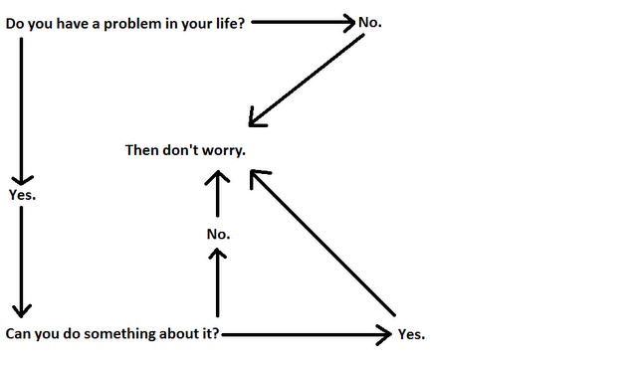
Look After #1 GCH
It is when the brain is in the ‘off state’ that we solve problems – Prof. Vin Walsh
The DON’T WORRY algorithm by Vern Gambetta
Create the Vision and Strategy
Shape the Environment
Conduct Practice and Competition
Read and React to the Field
Reflect and Learn
Build Relationships and Influence

Slide 28
Look After #1 GCH
How many plates can you spin at one time? How many can you drop safely? – Vern Gambetta
Take care of yourself or you won’t be able to take care of the team for long – Vern Gambetta
What is needed is radical self-compassion – Caroline McHugh
Create the Vision and Strategy
Shape the Environment
Conduct Practice and Competition
Read and React to the Field
Reflect and Learn
Build Relationships and Influence

Slide 29
Look After #1
Pressure means you have a chance
My energy comes from my family
My life away from the sport is my own problem. No one comes into it. It’s my time.
Create the Vision and Strategy
Shape the Environment
Conduct Practice and Competition
Read and React to the Field
Reflect and Learn
Build Relationships and Influence

Slide 30
Questions?
Create the Vision and Strategy
Shape the Environment
Conduct Practice and Competition
Read and React to the Field
Reflect and Learn
Build Relationships and Influence
Take Care of #1

